Slide 1



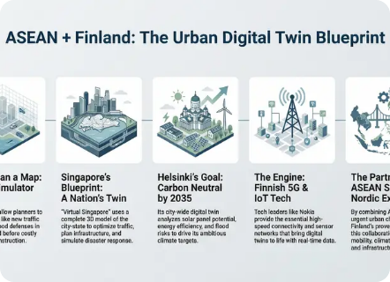
SMART CITY UTILITY NETWORK
DAA Innovation
Electricity • Water • Roads
HACKATHON FINALIST PRESENTATION
Optimizing Urban Infrastructure Through Intelligent Graph Algorithms
A graph-based decision-support system identifying minimum-cost connections, optimal routes, and isolated city regions in real time.
CORE OBJECTIVE
Automated Graph Optimization for Sustainable Urban Planning
TEAM MEMBERS:
T. Rishikesh
Y. Rahul
K. Suresh
S. Vedasagar
SLIDE 01 / 07

Slide 2




PROBLEM STATEMENT
The Urban Infrastructure Challenge
Capital Inefficiency
Infrastructure projects require massive capital investment; redundant cabling and piping inflate budgets.
Excessive Cost
Long Routes
Unnecessary connections increase material expenses.
Suboptimal paths increase transmission loss.
Isolated Regions
Poor routing leaves fringe residential and industrial zones disconnected from key utility backbones.
Manual Bottlenecks
Poor Access
Vulnerability
Traditional planning methods fail when scaling to thousands of interconnected junctions and nodes.
Crucial regions remain vulnerable to outages.
Single point of failure disruptions across city.
Smart City Utility Network • Problem Analysis
SLIDE 02 / 07

Slide 3


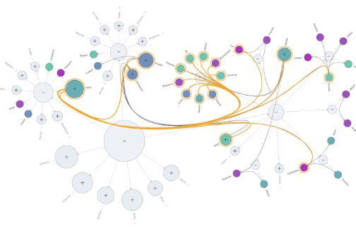
CORE ARCHITECTURE
One Platform. Three Algorithms. One Smart Network.
Graph Modeling
Nodes = Buildings & Area Junctions | Edges = Roads, Pipes & Power | Weights = Construction Cost
Interactive City Map
Cost & Connectivity Analytics
Dynamic spatial visualizer built with Leaflet for real-time inspection.
Automated step-by-step decision auditing for municipal planners.
We don't just show final output — we visually trace every algorithmic decision step.
Smart City Utility Network • Platform Innovation
SLIDE 03 / 07

Slide 4
OPERATIONAL WORKFLOW
System Workflow & End-to-End User Journey
1
2
3
4
5
USER INPUT
GRAPH CREATION
GRAPH ENGINES
COMPUTATION
DASHBOARD
City Nodes + Cable/Pipe Connections
Adjacency Matrix & Distance Mapping
MST | Dijkstra | Components
Min Cost + Routes + Isolated Zones
Cost + Route + Vulnerability
USER JOURNEY
1. Select Utility
2. Enter/Upload Network
3. Run Analysis
4. View Interactive Map
5. Inspect Results
Smart City Utility Network • Process Architecture
SLIDE 04 / 07

Slide 5




ALGORITHMIC RIGOR
Technology Stack & Core Graph Algorithms
Technology Stack
Minimum Spanning Tree (MST)
Kruskal O(E log E)
Connects all city nodes at absolute minimum total infrastructure cost without redundant loops.
Frontend
React.js Interactive UI
Dijkstra Shortest Path
Priority Queue O((V+E) log V)
Calculates least-cost transmission and shortest physical travel paths between any two junctions.
Map Engine
Leaflet Geospatial Renderer
Backend Engine
Python Network Analysis Core
Connected Components
BFS / DFS O(V+E)
Data Interface
Detects isolated, unserviced, or vulnerable urban sub-graphs requiring urgent grid extension.
JSON / CSV Utilities Schema
Smart City Utility Network • Algorithms & Stack
SLIDE 05 / 07

Slide 6

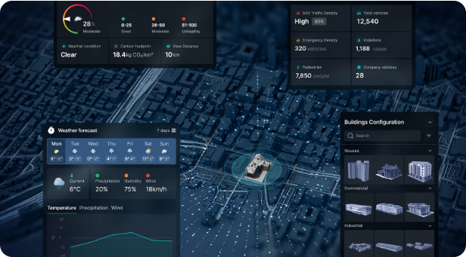
PRACTICAL APPLICATION
Interactive Dashboard Demo & Analytical Metrics
SAMPLE EXECUTION OUTPUT
20 Nodes
₹8.4 Lakhs
32 Infrastructure Edges
Optimized MST Cost
A → C → F → H
2 Components
Shortest Route (₹1.8L)
Vulnerable: Zone J
Lower Capital Expenditure
Guaranteed Connectivity
Instant Decision Speed
Explainable Graph Steps
Smart City Utility Network • Demo & Quantified Impact
SLIDE 06 / 07

Slide 7


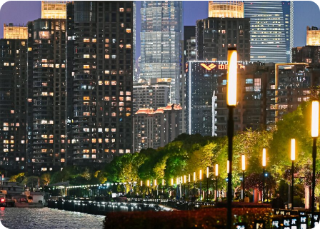
LOOKING FORWARD
Future Roadmap & Strategic Scalability
DEPLOYMENT SCALABILITY SPECTRUM
Campus
Municipality
Metropolis
Smart Region
Real-Time IoT Streams
AI Demand Forecasting
Live traffic congestion and dynamic utility load updates.
Predictive outage analysis and growth capacity planning.
GIS Map Integration
Failure Risk Resilience
Seamless sync with municipal spatial GIS datasets.
Automated backup route calculation during disruptions.
“Connect smarter. Travel efficiently. Build better cities.”
THANK YOU • Q & A

Slide 8




Image Sources
https://visionfinland.com/wp-content/uploads/2025/12/03-Digital-Twin-Infographics-01.webp
Source: visionfinland.com
https://www.yfiles.com/_astro/graph-aggregation.D9Eh-gAD_Z2r066f.png
Source: www.yfiles.com
https://cdn.dribbble.com/userupload/43376733/file/still-9d267de20d6c1baf8e708c327c227e5e.png
Source: dribbble.com
https://swissnex.org/app/uploads/sites/10/2025/05/ZSH_7839-opq3592362277-1200x628-c-default.jpg
Source: swissnex.org

